Slide 1
Linked Data Tutorial - Using OSLC Lyo
Jad El-khoury
jad@kth.se

Slide 2
Tutorial Objectives
After completing this session, you
Have experienced the Lyo capabilities
OSLC4J SDK
Lyo Modeller and code generator
Lyo Store
Have an overall understanding of the code structure for
a tool adaptor
Have an appreciation for the development needs of an adaptor.
Have the development environment in place.
Built an initial prototype for a Linked Data-based toolchain
Focused on a JIRA Adaptor
…
Notes:
→Aim is to get you started.
Tutorial cannot go through all the details, but will give an overview and some pointers.
Hopefully, this makes it easier for you to go through the details offline.

Slide 3

What is OSLC Lyo?
An Eclipse project to help the community adopt OSLC specifications and build OSLC-compliant tools.
Features includes
Software Development Kit (SDK) - OSLC4J
a Java toolkit for building OSLC providers and consumers.
Give developers tools to ease OSLC implementations
Modeller and Code Generator plugin
To graphically model a whole toolchain, according to the standard
To code generate an adaptor skeleton – based on OSLC4J SDK
Samples, tutorials and documentation
Working samples of OSLC integrations with Bugzilla, Excel, Jazz tools and more.
Reference implementations of specifications
A starting point for new integrations
Test suite
Will test OSLC domain provider implementations against the specification.
Covers a number of (but not all) OSLC specifications
https://www.eclipse.org/lyo
Notes:
What you will learn about that today
1. OSLC4J – a SDK/library to make it easier to develop OSLC-compliant servers/clients
NOT an Eclipse plugin – not related to the Eclipse IDE
Standalone set of tools (SDKs, sample, test suites)
Eclipse chosen has home for mature governance model, friendly IP policies
2. Lyo Designer
An Eclipse plugin
supports a model-based approach to OSLC4J development
Code generator…

Slide 4
Tutorial Format
Explore the initial steps of creating tool adapters to form a toolchain.
Example adaptors:
JIRA – for real
ActiveDirectory – Simulated to extract User information
Suggestion: Work in pairs
Notes:
→Aim is to get you started.
Tutorial cannot go through all the details, but will give an overview and some pointers.
Hopefully, this makes it easier for you to go through the details offline.

Slide 5
Agenda
The Task
The Tool[chain] Architecture
JIRA Configuration
Architecture - Version 1
Change Request with Literal properties
Architecture - Version 2
Project as a resource
(Adaptor Code Walkthrough)
Architecture - Version 3
Creator as a resource managed by another adaptor

Slide 6
Agenda
The Task
The Tool[chain] Architecture
JIRA Configuration
Architecture - Version 1
Change Request with Literal properties
Architecture - Version 2
Project as a resource
(Adaptor Code Walkthrough)
Architecture - Version 3
Creator as a resource managed by another adaptor

Slide 7
The Task
Implement an adapter for JIRA
Store JIRA Issues as ChangeRequest resources in a triplestore to improve performance
Create a toolchain since not all information resides in JIRA
For example, user information needs to be acquired from another software.
Implementing (parts of) the OSLC Change Management specification
http://open-services.net/bin/view/Main/CmSpecificationV2

Slide 8
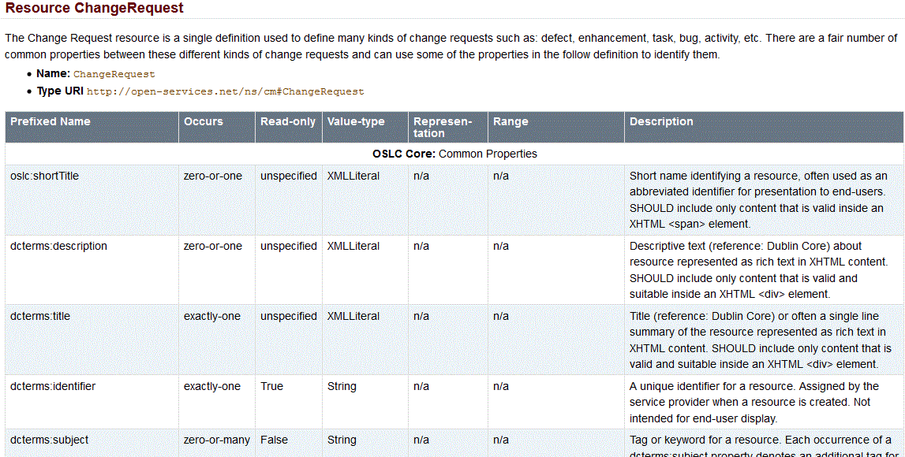
The OSLC Change Management Specification
http://open-services.net/bin/view/Main/CmSpecificationV2
Notes:
Browse through the simple specs.
Read the 1st paragraphs of the “Introduction”
Go through the ChangeRequest resource definition
Higlighting Literals + references (Person)

Slide 9
Agenda
The Task
The Tool[chain] Architecture
JIRA Configuration
Architecture - Version 1
Change Request with Literal properties
Architecture - Version 2
Project as a resource
(Adaptor Code Walkthrough)
Architecture - Version 3
Creator as a resource managed by another adaptor

Slide 10
The OSLC Way - - Federated Sources as OSLC Servers
Inter-tool interactions
Client-Server relationships
REST services for data access & manipulation
Delegated-UI for end-user GUI integration
Traceability managed within relevant tools
Test Management System
JIRA
Architecture Management Tool
PUT
GET
Source Code
(Perforce)
Requirement Management

Slide 11
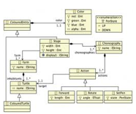
The OSLC Way - Federated Sources as OSLC Servers
OSLC Clients
Each source
controls it's own schema
Manages its own data
Delivers its own data
C.R.U.D.
Query
DelegatedUI
Tool
Adapter
Resources
OSLC
Technological
Space
Tool
Instance
Mapping
ElemA
ElemB
Artifact
ElemC
Tool
Technological
Space
(e.g., RIF,
Simulink)

Slide 12
The OSLC Way - Federated Sources as OSLC Servers
Limitations on complex queries
OSLC query capability has limited power
Queries can only be performed on each tool separately.
Solution?
Each source implements & provides a Tracked Resource Set (TRS) server interface to a central repository.
(Future Workshop)
Test Management System
JIRA
Architecture Management Tool
PUT
GET
GET
GET
GET
GET
Source Code
(Perforce)
Requirement Management
TrippleStore

Slide 13
Workshop Toolchain
JIRA
Active Directory
TripleStore
GET (Person)
QUERY
A JIRA adaptor
Queries an “Active Directory” adaptor to identify and link to Person resources.
Internally handles its resources in a triplestore
For better performance

Slide 14
The JIRA Adapter Architecture
A RESTful web application
To receive REST requests/notifications from JIRA’s Webhooks
To store Issues as Change Requests into a Triplestore
A client to an ActiveDirectory microservice/adaptor
to query for Persons
Technology
Builds on Lyo OSLC4J
Modelled and generated using Lyo Designer

Slide 15
The JIRA Adapter Architecture
Work through 3 incremental versions
Lyo Designer supports incremental model changes and generation
Version1: Change Request with Literal properties (id, title, description, creator, project)
Version2: Project as a resource
Version3: Creator as a resource – managed by another adaptor.
Notes:
3 incremental versions

Slide 16
Agenda
The Task
The Tool[chain] Architecture
JIRA Configuration
Architecture - Version 1
Change Request with Literal properties
Architecture - Version 2
Project as a resource
(Adaptor Code Walkthrough)
Architecture - Version 3
Creator as a resource managed by another adaptor

Slide 17

-1. Configure JIRA Webhooks
Webhooks are user-defined HTTP POST callbacks.
Lightweight mechanism for letting remote applications receive push notifications from JIRA
No polling.
For example, changes in JIRA bugs pushed to a test management system, so that they can be retested.
Notes:
https://confluence.atlassian.com/adminjiraserver072/managing-webhooks-828787627.html

Slide 18
Create a RequestBin to receive JIRA Webhook requests
Go to http://requestb.in/
Select ”Create a RequestBin”
Record the Bin URL
For example, http://requestb.in/pq2hggpq

Slide 19
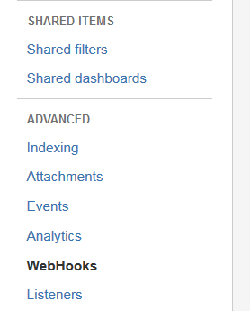
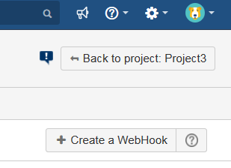
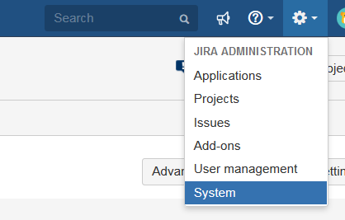
Create a JIRA WebHook
Browse to JIRA on http://localhost:2990/secure/Dashboard.jspa
Select Settings→System
From the left menu, select WebHooks
Select ”Create a WebHook”
Port number may vary!
4
2
3
Notes:
https://confluence.atlassian.com/adminjiraserver072/managing-webhooks-828787627.html
Of course, the port number may vary

Slide 20
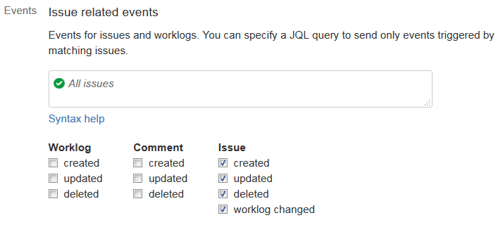
Configure the JIRA Webhook
Create a WebHook that triggers events on all Issues – for all types of changes
URL: Enter the RequestBin URL.
Events: all issue events

Slide 21
Test & Understand the Webhook request content
Create an Issue in Jira
Inspect content of latest POST request under http://requestb.in/pq2hggpq?inspect
See Content under “RAW BODY”
Note: Need to add “?inspect” to your URL
Hard to make sense of the json?
Copy the Raw Body content to http://json.parser.online.fr/

Slide 22
Agenda
The Task
The Tool[chain] Architecture
JIRA Configuration
Architecture - Version 1
Change Request with Literal properties
Architecture - Version 2
Project as a resource
(Adaptor Code Walkthrough)
Architecture - Version 3
Creator as a resource managed by another adaptor

Slide 23
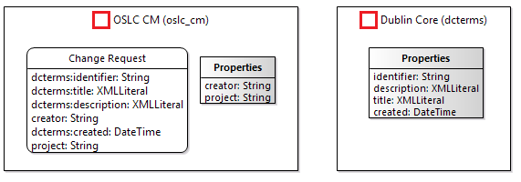
Architecture - Version 1 - Change Request with Literal properties

Slide 24
Create a toolchain Modelling Project
Create a Lyo Designer modelling project
Follow instructions under: https://wiki.eclipse.org/Lyo/ToolchainModellingAndCodeGenerationWorkshop#Create_modelling_project
Suggested project name: toolchain-model

Slide 25
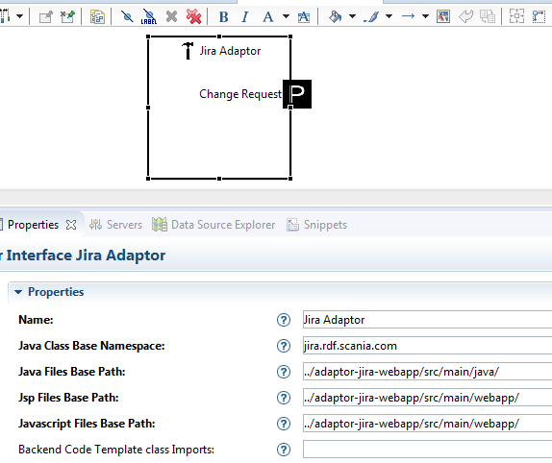
Model the Toolchain
In the Specification Diagram, design the desired information model
In the Toolchain Diagram, create a toolchain model with 1 adaptor – JIRA
Set the adaptor properties accordingly
Double-click on the Adaptor element – to view the default adaptor design
Can you relate the design to the OSLC concepts?
1
2
3
domain | prefix
http://www.w3.org/2000/01/rdf-schema# | RDFS
http://purl.org/dc/terms/ | Dcterms
http://open-services.net/ns/cm# | oslc_cm
http://rdf.example.com/ns/jira# | jira

Slide 26
Setup JIRA Adaptor Project
Create an Eclipse web project for the Jira Adaptor
Follow instructions under: https://wiki.eclipse.org/Lyo/creating_OSLC4J_project
Place the project at the same location as the modelling project
Suggested values to use:
Project Name: adaptor-jira-webapp
Base Package Name for Java Classes: jira.rdf.example.com
Port: 8081
contextPath: “/adaptor-jira”

Slide 27
Generate Adaptor Code
Right-click on toolchain.xml file in the Project Explorer
Select ” OSLC Lyo Designer > Generate Complete Toolchain …”
Inspect the generated classes in the JIRA adaptor
Resources package - reflected annotated Java classes
Services package – reflected as JAX-RS classes
Can’t find the source code?
Right click the adaptor project
Select Refresh (F5)
You see many compile errors?
Right click the adaptor project
Select “Maven→Update Project …”
We will study the code in detail a bit later

Slide 28

Add a JAX-RS service to capture WebHook requests
Create a JAX-RS Class to handle WebHook requests
<services\JiraWebhooksService.java>
package jira.rdf.example.com.services;
import javax.servlet.http.HttpServletRequest;
import javax.servlet.http.HttpServletResponse;
import javax.ws.rs.Path;
import javax.ws.rs.core.Context;
import javax.ws.rs.core.UriInfo;
import org.slf4j.Logger;
import org.slf4j.LoggerFactory;
@Path("jira/webhooks")
public class JiraWebhooksService
{
@Context private HttpServletRequest httpServletRequest;
@Context private HttpServletResponse httpServletResponse;
@Context private UriInfo uriInfo;
private static final Logger log = LoggerFactory.getLogger(JiraWebhooksService.class);
public JiraWebhooksService()
{
super();
}
}

Slide 29
Register the JAX-RS service
Register the JAX-RS service/class
<Application.java> (under the servlet package)
// Start of user code Custom Resource Classes
RESOURCE_CLASSES.add(JiraWebhooksService.class);
// End of user code

Slide 30
Capture the JIRA WebHook requests
Define a method that responds to JIRA POST WebHook requests.
<services\JiraWebhooksService.java>
@POST
@Path("issues")
@Produces({ MediaType.TEXT_HTML })
public Response handleIssuesWebhooks() throws ServletException, IOException, URISyntaxException
{
ServletInputStream inputStream = httpServletRequest.getInputStream();
ObjectMapper mapper = new ObjectMapper();
Map<String,Object> jsonData = new HashMap<String,Object>();
jsonData = mapper.readValue(inputStream, Map.class);
LinkedHashMap<String,Object> issueData = (LinkedHashMap<String, Object>) jsonData.get("issue");
try {
//Transform the Json Issue into a ChangeRequest resource.
ChangeRequest aChangeRequest = getChangeRequest(issueData);
//Save the ChangeRequest resource into a triplestore.
JiraAdaptorManager.store.updateResources(new URI ("urn:x-arq:DefaultGraph"), aChangeRequest);
} catch (Exception e) {
log.error("Failed to update an Issues resource", e);
}
return Response.ok().build();
}
To be
implemented

Slide 31
Use Jackson library to handle JSON content
Add dependencies to Jackson in the pom.xml file.
<dependency>
<groupId>com.fasterxml.jackson.core</groupId>
<artifactId>jackson-core</artifactId>
<version>2.6.4</version>
</dependency>
<dependency>
<groupId>com.fasterxml.jackson.core</groupId>
<artifactId>jackson-databind</artifactId>
<version>2.6.4</version>
</dependency>

Slide 32
Use Lyo Store to persist resources
Add dependency to Lyo-Store in the pom.xml file.
<dependency>
<groupId>org.eclipse.lyo.store</groupId>
<artifactId>store-core</artifactId>
<version>2.2.0</version>
</dependency>
Right after the `</dependencies>` tag, add the following:
<dependencyManagement>
<dependencies>
<dependency>
<groupId>org.apache.jena</groupId>
<artifactId>jena-core</artifactId>
<version>2.13.0</version>
</dependency>
</dependencies>
</dependencyManagement>
Create a Properties file with triplestore details (\src\main\resources\jira.properties)
sparqlQueryUrl=http://localhost:3030/JiraDataset/query
sparqlUpdateUrl=http://localhost:3030/JiraDataset/update

Slide 33
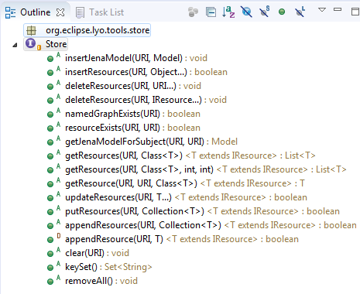
What is Lyo Store?
A simple interface for managing OSLC resources in a triplestore.
https://wiki.eclipse.org/Lyo/Store

Slide 34
Transform JIRA Issue to a ChangeRequest resource
Define a method that transforms an Issue (JSON from the request) into a ChangeRequest (RDF resource) instance.
<services\JiraWebhooksService.java>
public ChangeRequest getChangeRequest(LinkedHashMap<String,Object> issueData) throws URISyntaxException
{
ChangeRequest aChangeRequest = new ChangeRequest();
aChangeRequest.setIdentifier((String) issueData.get("id"));
LinkedHashMap<String,Object> issueFieldsData = (LinkedHashMap<String, Object>) issueData.get("fields");
aChangeRequest.setDescription((String) issueFieldsData.get("description"));
aChangeRequest.setTitle((String) issueFieldsData.get("summary"));
LinkedHashMap<String,Object> projectData = (LinkedHashMap<String, Object>) issueFieldsData.get("project");
String projectName = (String) projectData.get("name");
aChangeRequest.setProject(projectName);
LinkedHashMap<String,Object> creatorData = (LinkedHashMap<String, Object>) issueFieldsData.get("creator");
aChangeRequest.setCreator((String) creatorData.get("name"));
aChangeRequest.setAbout(ChangeRequest.constructURI("1", aChangeRequest.getIdentifier()));
return aChangeRequest;
}

Slide 35
Connect JIRA Adaptor to the Triplestore
Add a store class attribute to the main Manager class (and a logger)
<\JiraAdaptorManager.java>
// Start of user code class_attributes
public static Store store = null;
private static final Logger log = LoggerFactory.getLogger(JiraAdaptorManager.class);
// End of user code
Create a connection to the store in the Manager class
public static void contextInitializeServletListener(final ServletContextEvent servletContextEvent)
{
// Start of user code contextInitializeServletListener
try {
Properties props = new Properties();
props.load(new FileInputStream("src\\main\\resources\\jira.properties"));
String sparqlQueryUrl = props.getProperty("sparqlQueryUrl");
String sparqlUpdateUrl = props.getProperty("sparqlUpdateUrl");
store = StoreFactory.sparql(sparqlQueryUrl, sparqlUpdateUrl);
} catch (IOException e) {
log.error("problem loading properties file", e);
System.exit(1);
}
// End of user code
}

Slide 36
Save the ChangeRequest resource into a triplestore
@POST
@Path("issues")
@Produces({ MediaType.TEXT_HTML })
public Response handleIssuesWebhooks() throws ServletException, IOException, URISyntaxException
{
ServletInputStream inputStream = httpServletRequest.getInputStream();
ObjectMapper mapper = new ObjectMapper();
Map<String,Object> jsonData = new HashMap<String,Object>();
jsonData = mapper.readValue(inputStream, Map.class);
LinkedHashMap<String,Object> issueData = (LinkedHashMap<String, Object>) jsonData.get("issue");
try {
//Transform the Json Issue into a ChangeRequest resource.
ChangeRequest aChangeRequest = getChangeRequest(issueData);
//Save the ChangeRequest resource into a triplestore.
JiraAdaptorManager.store.updateResources(new URI ("urn:x-arq:DefaultGraph"), aChangeRequest);
} catch (Exception e) {
log.error("Failed to update an Issues resource", e);
}
return Response.ok().build();
}

Slide 37
Redirect the JIRA WebHook to the JIRA Adaptor
Reconfigure the JIRA WebHook to point to
http://localhost:8081/adaptor-jira/services/jira/webhooks/issues
Alternatively, create another WebHook, keeping the RequestBin requests for debugging purposes.

Slide 38
Test!
Run JIRA adaptor in debug mode
Select “Run As → Maven build ...” from the project's context menu, and set the goal to “clean jetty:run”.
Place a breakpoint at start of handleIssuesWebhooks() method.
Make sure your Fuseki server is running
Create a new Issue in Jira
Step through code
Check that triples are stored in triplestore
SELECT ?subject ?predicate ?object
{
?subject ?predicate ?object .
#values ?subject { <http://localhost:8083/adaptor-jira/services/serviceProviders/1/service1/changeRequests/10000> }
}
Update an existing Issue
Check that triples are updated in triplestore

Slide 39
Agenda
The Task
The Tool[chain] Architecture
JIRA Configuration
Architecture - Version 1
Change Request with Literal properties
Architecture - Version 2
Project as a resource
(Adaptor Code Walkthrough)
Architecture - Version 3
Creator as a resource managed by another adaptor

Slide 40
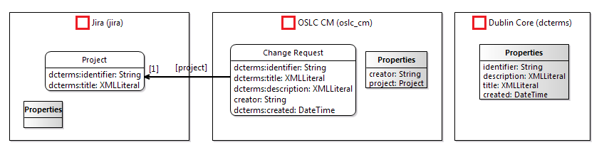
Architecture - Version 2 - Project as a resource
Change the project from String literal to RDF resource, with
identifier: String
title: XMLLiteral
Design the adaptor to include
(a) basic (b) query capability on Person resources
(a) basic (b) query capability on Project resources

Slide 41
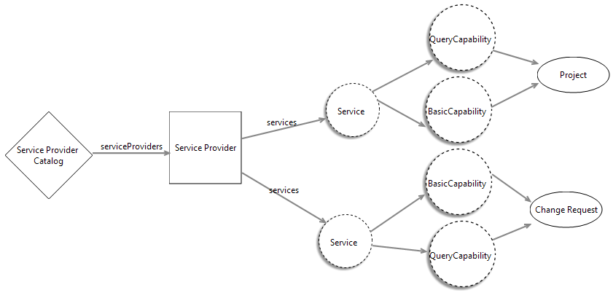
Architecture - Version 2 - Project as a resource
Change the project from String literal to RDF resource
Design the adaptor to include
(a) basic (b) query capability on Person resources
(a) basic (b) query capability on Project resources

Slide 42
Generate Adaptor Code
(optional) Commit your code to Git – before regeneration
This allows you to easily see changes made.
Re-generate Adaptor Code
Browse code changes
Note that [properly inserted] code changes are not lost. Or, are they?

Slide 43
Transform JIRA Issue to a ChangeRequest & Project resources
Modify getChangeRequest() method ...
<services\JiraWebhooksService.java>
public ChangeRequest getChangeRequest(LinkedHashMap<String,Object> issueData) throws URISyntaxException
{
ChangeRequest aChangeRequest = new ChangeRequest();
aChangeRequest.setIdentifier((String) issueData.get("id"));
LinkedHashMap<String,Object> issueFieldsData = (LinkedHashMap<String, Object>) issueData.get("fields");
aChangeRequest.setDescription((String) issueFieldsData.get("description"));
aChangeRequest.setTitle((String) issueFieldsData.get("summary"));
LinkedHashMap<String,Object> projectData = (LinkedHashMap<String, Object>) issueFieldsData.get("project");
//String projectName = (String) projectData.get("name");
//aChangeRequest.setProject(projectName);
String projectId = (String) projectData.get("id");
aChangeRequest.setProject(Project.constructLink("1", projectId));
LinkedHashMap<String,Object> creatorData = (LinkedHashMap<String, Object>) issueFieldsData.get("creator");
aChangeRequest.setCreator((String) creatorData.get("name"));
aChangeRequest.setAbout(ChangeRequest.constructURI("1", aChangeRequest.getIdentifier()));
return aChangeRequest;
}

Slide 44
Test!
Run Jira adaptor in debug mode
Compile Problems?
I am sure I added the Import statements, which are now lost! I thought regeneration does not override manual changes.
Questions:
We only link from a ChangeRequest to the Project
Where is the Project resource?
Webhooks are only handling changes to JIRA items
How do we capture the existing Issues and Projects?

Slide 45
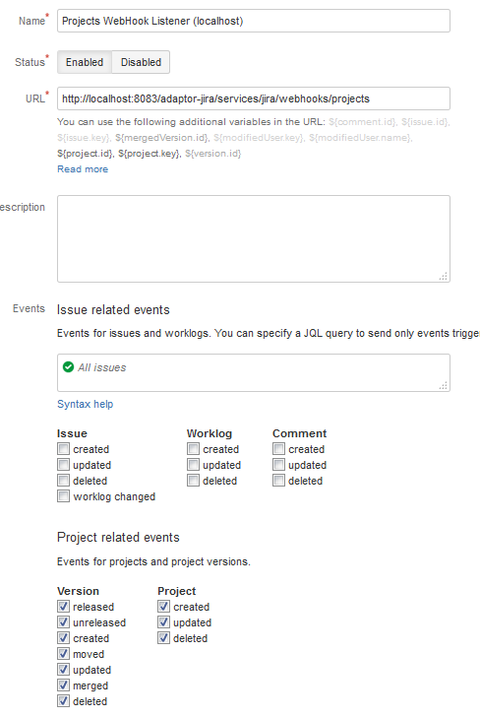
Handle JIRA Projects

Slide 46
Handle JIRA Projects
Define methods to handle Project notifications.
<services\JiraWebhooksService.java>
public Project getProject(LinkedHashMap<String,Object> projectData) throws URISyntaxException
{
Project project = new Project();
String projectId = projectData.get("id").toString();
project.setIdentifier(projectId);
project.setTitle((String) projectData.get("name"));
project.setAbout(Project.constructURI("1", project.getIdentifier()));
return project;
}
@POST
@Path("projects")
@Produces({ MediaType.TEXT_HTML })
public Response handleProjectsWebhooks() throws ServletException, IOException, URISyntaxException
{
ServletInputStream inputStream = httpServletRequest.getInputStream();
ObjectMapper mapper = new ObjectMapper();
Map<String,Object> jsonData = new HashMap<String,Object>();
jsonData = mapper.readValue(inputStream, Map.class);
LinkedHashMap<String,Object> projectData = (LinkedHashMap<String, Object>) jsonData.get("project");
Project project = getProject(projectData);
try {
JiraAdaptorManager.store.updateResources(new URI ("urn:x-arq:DefaultGraph"), project);
} catch (Exception e) {
log.error("Failed to update an Project resource", e);
}
return Response.ok().build();
}

Slide 47
Handle Existing Issues & Projects
@GET
@Path("initIssues")
@Produces({ MediaType.TEXT_HTML })
public Response initializeIssues() throws ServletException, IOException, URISyntaxException
{
try {
final String username = "admin";
final String password = "admin";
final String basePath = "http://localhost:8080/"; //or add "/jira" to end?
final int pageSize = 2;
int startAt = 0;
int maxResults = pageSize;
while (true){
UriBuilder builder = UriBuilder.fromUri(basePath);
builder.path("rest/api/2/search");
//builder.queryParam("assignee", "admin");
builder.queryParam("startAt", startAt);
builder.queryParam("maxResults", maxResults);
HttpClient client = new DefaultHttpClient();
HttpGet request = new HttpGet(builder.build());
String encoding = Base64.getEncoder().encodeToString((username + ":" + password).getBytes());
request.setHeader("Authorization", "Basic " + encoding);
request.setHeader("Accept", "application/json");
HttpResponse response = client.execute(request);
InputStream inputStream = response.getEntity().getContent();
ObjectMapper mapper = new ObjectMapper();
Map<String,Object> jsonData = new HashMap<String,Object>();
jsonData = mapper.readValue(inputStream, Map.class);
ArrayList<Object> issuesData = (ArrayList<Object>) jsonData.get("issues");
if (issuesData.size() == 0){
break;
}
ChangeRequest[] issues = new ChangeRequest[issuesData.size()];
int i = 0;
for (Object issueData : issuesData) {
issues[i] = getChangeRequest((LinkedHashMap<String, Object>) issueData);
i++;
}
try {
JiraAdaptorManager.store.updateResources(new URI ("urn:x-arq:DefaultGraph"), issues);
} catch (Exception e) {
log.error("Failed to perform an initial update of Issues resources", e);
}
startAt = startAt+maxResults;
}
} catch (Exception e) {
log.error("Failed to perform an initial update of Issues resources", e);
}
return Response.ok().build();
}

Slide 48
Test!
Run Jira adaptor in debug mode
Make a GET request to initialize all Issues
http://localhost:8081/adaptor-jira/services/jira/webhooks/initIssues
Modify a Project

Slide 49
Agenda
The Task
The Tool[chain] Architecture
JIRA Configuration
Architecture - Version 1
Change Request with Literal properties
Architecture - Version 2
Project as a resource
(Adaptor Code Walkthrough)
Architecture - Version 3
Creator as a resource managed by another adaptor

Slide 50
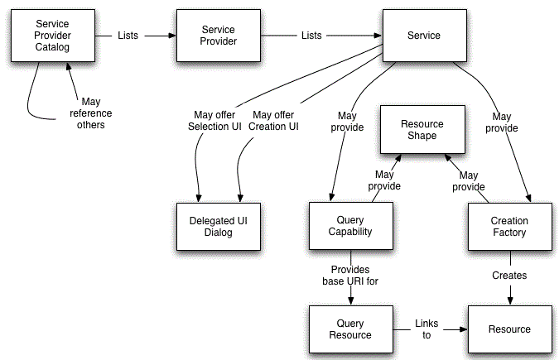
Code Walkthrough - A break from programming
Explore the Java code that realises the following:
Resources
Resource Shapes
Services on resources
Service Provider Catalog
Service Providers
Notes:
I will guide you through SPC. I will explain
how to debugg,
how to interpret the code.
…
Can do the rest on your own, but we take it 1 step at a time.

Slide 51
But First … … a small hack
Define a single ServiceProvider instance
<JiraAdaptorManager.java>
public static ServiceProviderInfo[] getServiceProviderInfos(HttpServletRequest httpServletRequest)
{
ServiceProviderInfo[] serviceProviderInfos = {};
// Start of user code "ServiceProviderInfo[] getServiceProviderInfos(...)"
ServiceProviderInfo anSP = new ServiceProviderInfo();
anSP.name = "the only SP";
anSP.serviceProviderId = "1";
serviceProviderInfos = new ServiceProviderInfo[1];
serviceProviderInfos[0] = anSP;
// End of user code
return serviceProviderInfos;
}

Slide 52
But First … … another small hack
Implement method to return a ChangeRequest upon GET requests
<JiraAdaptorManager.java>
public static ChangeRequest getChangeRequest(HttpServletRequest httpServletRequest, final String serviceProviderId, final String changeRequestId)
{
ChangeRequest aResource = null;
// Start of user code getChangeRequest
try {
URI changeRequestUri = ChangeRequest.constructURI(serviceProviderId, changeRequestId);
aResource = JiraAdaptorManager.store.getResource(new URI ("urn:x-arq:DefaultGraph"), changeRequestUri, ChangeRequest.class);
} catch (Exception e) {
log.error("Failed to get a ChangeRequest resource", e);
}
// End of user code
return aResource;
}

Slide 53
But First … … a final small hack
Implement method to return all ChangeRequests
<JiraAdaptorManager.java>
public static List<ChangeRequest> queryChangeRequests(HttpServletRequest httpServletRequest, final String serviceProviderId, String where, int page, int limit)
{
List<ChangeRequest> resources = null;
// Start of user code queryChangeRequests
try {
resources = new ArrayList<ChangeRequest>(JiraAdaptorManager.store.getResources(new URI ("urn:x-arq:DefaultGraph"), ChangeRequest.class));
} catch (Exception e) {
log.error("Failed to get ChangeRequest resources", e);
}
// End of user code
return resources;
}

Slide 54
And Now … … a Demo
http://localhost:8081/adaptor-jira/
Notes:
Demonstrate
Queries as HTML
Queries as RDF
Resource Shape as HTML
Resource Shape as RDF
1 Resource as HTML
1 Resource as RDF
1 Resource from Tripplestore

Slide 55
Overall Code Structure
Package: jira.rdf.example.com.resources
for each OSLC-resource of relevance, a corresponding Java class is defined.
Package: jira.rdf.example.com.services
Contains the JAX-RS classes, with methods corresponding to the OSLC services for ServiceProviderCatalogs, ServiceProviders, and resources.
Each JAX-RS class contains the necessary methods that correspond to
Query Capabilities, Creation Factories, Dialogs,
The C.R.U.D. methods to handle resources.
Each JAX-RS class contains methods to respond to both HTML and RDF/XML requests.
Package jira.rdf.example.com
The class JiraAdaptorManager contains the set of methods that will ultimately communicate with the source tool to access its internal data.
Folder src/main/webapp/jira/rdf/example/com
Contains the JSP-templates for HTML representations:
ServiceProviderCatalog & ServiceProvider presentations
Resource presentations
Query results
creation & selection dialogs
Notes:
→ In Eclipse, let’s browse through the packages of the BugzillaAdaptor project
1 OSLC REST service = 1 JAX-RS method
we use a simple pattern to implement OSLC REST services: for each operation, a JAX-RS method will accept incoming requests, load the data necessary to render a response, perform the requested operation, and then render the resulting RDF or other representations.
JSP templates
JSP simply puts Java inside HTML pages.
You can embed Java, between the sequences <% and %>
The java is evalulated dynamically at runtime.
CRUD methods
Create, Read, Update and Delete
The basic/primitive functions/operations of handling a resource

Slide 56
Resources - as Java Classes
Each OSLC resource is defined as a Java class
Annotations provide the necessary information to
create resource shapes
serialize/de-serialize a resources from Java to RDF or JSON.
Explore the class ChangeRequest
package jira.rdf.example.com.resources
This corresponds to the Change Request OSLC-resource
Study the methods and attributes
In particular, study the get-methods and their annotations
Relate to the Change Request definition in the OSLC CM specification
open-services.net/bin/view/Main/CmSpecificationV2#Resource_ChangeRequest
Notes:
Analysis notes:
1. the private variables of the ChangeRequest class → the attributes of an OSLC CM V2.0 Change Request.
* some represent relationships to other OSLC artifacts
* Some are primitive attributes
2. Getters/Setters
→ Note the @annotations
…
3. Bugzilla bugs also have attributes that do not map to any OSLC Change Management properties but that are required for Bugzilla.
We should make these available in our RDF/XML representations

Slide 57
Resource Services - as JAX-RS classes
Explore the JAX-RS class ChangeRequestService
package jira.rdf.example.com.services
Contains the services (JAX-RS methods) provided by each Service Provider
Study the JAX-RS annotations throughout the class
@Path at the class and method levels
@Consumes, @Produces
Study the OSLC annotations throughout the class
@OslcQueryCapability
@OslcDialog
@OslcCreationFactory
Study the methods
What is the functionality of each method?
What URI does each method respond to?
What are the parameters & return values?
Notes:
We will dig deaper into each of the methods in later slides.

Slide 58
Resource Services - C.R.U.D. methods
Explore the JAX-RS class ChangeRequestService
Relevant methods
getChangeRequest()
getChangeRequestAsHtml()
Study the above methods
What is the functionality of each method?
What URI does each method respond to?
What is the meaning of the annotations?
What are the parameters & return values?
Run the adaptor, and observe the response from each URI request
Run in debug mode - with suitable breakpoints – to step through the code.
In particular,
Study the method getChangeRequest() in the class JiraAdaptorManager
Study the jsp-template "\webapp\jira\rdf\example\com\changerequest.jsp"
Notes:
methods to GET an individual BugzillaChangeRequest in both formats.

Slide 59
Resource Services - Query Capabilities
Explore the JAX-RS class ChangeRequestService
Relevant methods
queryChangeRequests()
queryBugzillaChangeRequestsAsHtml()
Study the above methods
What is the functionality of each method?
What URI does each method respond to?
What is the meaning of the annotations?
What are the parameters & return values?
Run the adaptor, and observe the response from each URI request
Run in debug mode - with suitable breakpoints – to step through the code.
In particular,
Study the method queryChangeRequests() in the class JiraAdaptorManager
Study the jsp-template "\webapp\jira\rdf\example\com\changerequestscollection.jsp"
Notes:
Ask them to explore the jsp template.
@OslcQueryCapability
With these annotations, oslc4j will register the dialog capability under the respective ServiceProvider Service.

Slide 60
Tips - Resource Representations
HTML representations
Useful for debugging
Produced using JSP-templates.
RDF+XML and JSON representations
machine-readable formats
Produced through the OSLC4J toolkit
Notes:
JSP templates:
You build the data for the resource and then dispatch to a JSP template to output it in the proper format.
OSLC4J
The OSLC4J toolkit serializes the Java representation of any OSLC resource to
RDF+XML, JSON, or XML.
Likewise, it can convert OSLC resources in any of those formats back into Java objects.

Slide 61
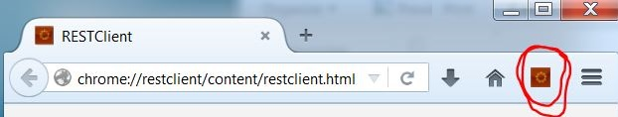
Tips - Viewing Resource Representations
HTML representations
Explore through any web browser
RDF+XML and JSON representations
Open the RESTClient Firefox plugin
Sends HTTP requests with more control over HTTP headers
In the URL field, type the desired URL
In the Method field, select the desired HTTP Method.
Using Headers → Custom Header, add the desired headers
Example: To specify the desired media type acceptable in the response
In the Header window, enter
Name: “Accept”
Value: “application/rdf+xml” or “application/json” or “application/xml” or “text/html”
Select “Save to favorite” for future reuse
Click Send
Observe the Response results, in particular the Response Body
Notes:
“media type” such as audio or “text/plain” or html

Slide 62
Agenda
The Task
The Tool[chain] Architecture
JIRA Configuration
Architecture - Version 1
Change Request with Literal properties
Architecture - Version 2
Project as a resource
(Adaptor Code Walkthrough)
Architecture - Version 3
Creator as a resource managed by another adaptor

Slide 63
Architecture - Version 3 - Creator as a resource managed by another adaptor
User information is obtained from an external system
An ActiveDirectory adaptor already inserted Person resources into the tripleStore.
Jira adaptor (as a client) queries the tripleStore for Persons.

Slide 64
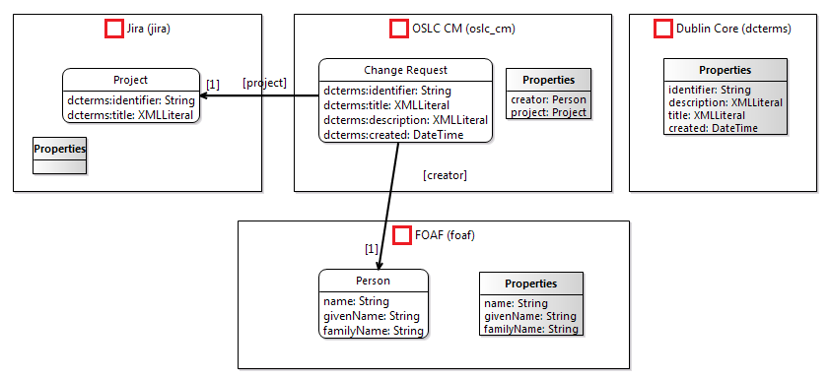
Architecture - Version 3 - Creator as a resource managed by another adaptor
Change the creator from a String literal to an RDF resource
Introduce an ActiveDirectory adaptor
Redesign JIRA adaptor to consume Person resources
domain | Prefix
http://xmlns.com/foaf/0.1/# | foaf

Slide 65
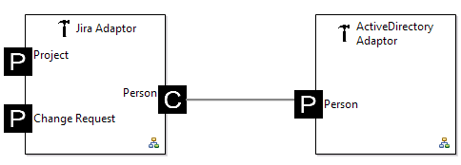
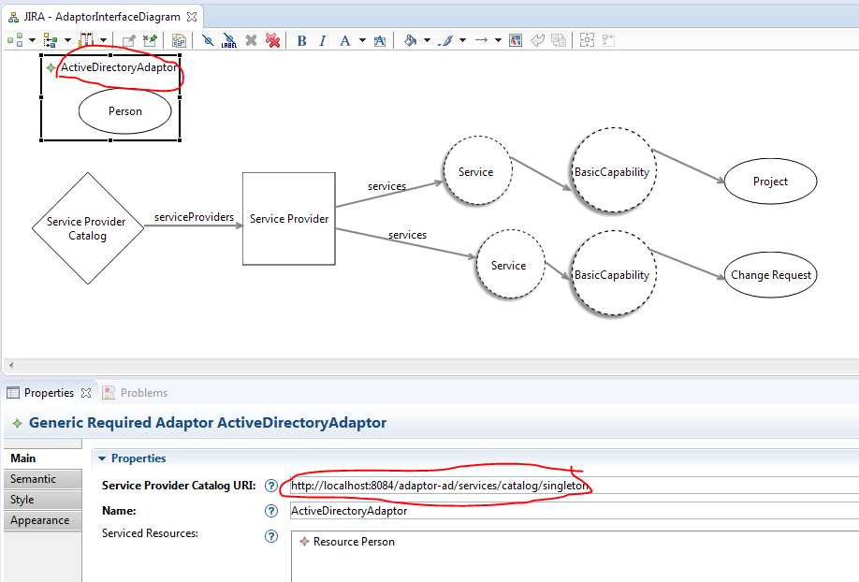
Architecture - Version 3 - Creator as a resource managed by another adaptor
Change the creator from a String literal to an RDF resource
Introduce an ActiveDirectory adaptor
Design the adaptor to include a query capability on Person resources
Design the Adaptor to include a basic capability on Person resources
Redesign JIRA adaptor to consume Person resources

Slide 66
Setup ActiveDirectory Adaptor Project
Create an Eclipse web project for the adaptor
Instructions: https://wiki.eclipse.org/Lyo/creating_OSLC4J_project
Place the project at the same location as the modelling project
Suggested values to use:
Project Name: adaptor-ad-webapp
Base Package Name for Java Classes: jira.rdf.example.com
Port: 8082
contextPath: “/adaptor-ad”

Slide 67
Use Lyo Store to persist Person resources
Add dependency to Lyo-Store in the pom.xml file.
<dependency>
<groupId>org.eclipse.lyo.store</groupId>
<artifactId>store-core</artifactId>
<version>2.2.0</version>
</dependency>
Right after the `</dependencies>` tag, add the following:
<dependencyManagement>
<dependencies>
<dependency>
<groupId>org.apache.jena</groupId>
<artifactId>jena-core</artifactId>
<version>2.13.0</version>
</dependency>
</dependencies>
</dependencyManagement>
Create a Properties file with triplestore details (\src\main\resources\jira.properties)
sparqlQueryUrl=http://localhost:3030/JiraDataset/query
sparqlUpdateUrl=http://localhost:3030/JiraDataset/update

Slide 68
Connect Adaptor to the Triplestore
Add a store class attribute to the main Manager class (and a logger)
<\ActiveDirectoryAdaptorManager.java>
// Start of user code class_attributes
public static Store store = null;
private static final Logger log = LoggerFactory.getLogger(ActiveDirectoryAdaptorManager.class);
// End of user code
Create a connection to the store in the Manager class
public static void contextInitializeServletListener(final ServletContextEvent servletContextEvent)
{
// Start of user code contextInitializeServletListener
try {
Properties props = new Properties();
props.load(new FileInputStream("src\\main\\resources\\jira.properties"));
String sparqlQueryUrl = props.getProperty("sparqlQueryUrl");
String sparqlUpdateUrl = props.getProperty("sparqlUpdateUrl");
store = StoreFactory.sparql(sparqlQueryUrl, sparqlUpdateUrl);
} catch (IOException e) {
log.error("problem loading properties file", e);
System.exit(1);
}
// End of user code
}

Slide 69
Update triplestore with ActiveDirectory Person resources
We will simulate the real application
Insert Person data into Triplestore
INSERT DATA {
<http://localhost:8084/adaptor-ad/services/serviceProviders/1/persons/jelx25> <http://xmlns.com/foaf/0.1/#familyName> "El-khoury" .
<http://localhost:8084/adaptor-ad/services/serviceProviders/1/persons/jelx25> <http://xmlns.com/foaf/0.1/#givenName> "jad" .
<http://localhost:8084/adaptor-ad/services/serviceProviders/1/persons/jelx25> <http://xmlns.com/foaf/0.1/#name> "jelx25" .
<http://localhost:8084/adaptor-ad/services/serviceProviders/1/persons/jelx25> <http://www.w3.org/1999/02/22-rdf-syntax-ns#type> <http://xmlns.com/foaf/0.1/#Person> .
<http://localhost:8084/adaptor-ad/services/serviceProviders/1/persons/admin> <http://xmlns.com/foaf/0.1/#familyName> "El-admin" .
<http://localhost:8084/adaptor-ad/services/serviceProviders/1/persons/admin> <http://xmlns.com/foaf/0.1/#givenName> "admin" .
<http://localhost:8084/adaptor-ad/services/serviceProviders/1/persons/admin> <http://xmlns.com/foaf/0.1/#name> "admin" .
<http://localhost:8084/adaptor-ad/services/serviceProviders/1/persons/admin> <http://www.w3.org/1999/02/22-rdf-syntax-ns#type> <http://xmlns.com/foaf/0.1/#Person> .
}

Slide 70
Remember that small hack - Need at least 1 Service Provider
Define a single ServiceProvider instance
<ActiveDirectoryAdaptorManager.java>
public static ServiceProviderInfo[] getServiceProviderInfos(HttpServletRequest httpServletRequest)
{
ServiceProviderInfo[] serviceProviderInfos = {};
// Start of user code "ServiceProviderInfo[] getServiceProviderInfos(...)"
ServiceProviderInfo anSP = new ServiceProviderInfo();
anSP.name = "the only SP";
anSP.serviceProviderId = "1";
serviceProviderInfos = new ServiceProviderInfo[1];
serviceProviderInfos[0] = anSP;
// End of user code
return serviceProviderInfos;
}

Slide 71
Remember that other small hack - return a Person resource from Store
Implement getPerson() method to return a Person upon GET requests
<ActiveDirectoryAdaptorManager.java>
public static Person getPerson(HttpServletRequest httpServletRequest, final String serviceProviderId, final String personId)
{
Person aResource = null;
// Start of user code getPerson
try {
URI changeRequestUri = Person.constructURI(serviceProviderId, personId);
aResource = ActiveDirectoryAdaptorManager.store.getResource(new URI ("urn:x-arq:DefaultGraph"), changeRequestUri, Person.class);
} catch (Exception e) {
log.error("Failed to get a ChangeRequest resource", e);
}
// End of user code
return aResource;
}

Slide 72
Develop Query Capability
Implement queryPersons() method
<ActiveDirectoryAdaptorManager.java>
public static List<Person> queryPersons(HttpServletRequest httpServletRequest, final String serviceProviderId, String where, int page, int limit)
{
List<Person> resources = null;
// Start of user code queryPersons
// This is a very primitive query functionality. We ought to at least
// use the proper term oslc.searchTerms for such a search, instead of "where".
try {
resources = new ArrayList<Person>();
List<Person> allResources = store.getResources(new URI("urn:x-arq:DefaultGraph"), Person.class, 100, 0);
for (Person person : allResources) {
if ((where == null) || (person.getName().equals(where)))
resources.add(person);
}
} catch (Exception e) {
log.error("Failed to get a User resource based on query", e);
return new ArrayList<Person>();
}
// End of user code
return resources;
}

Slide 73
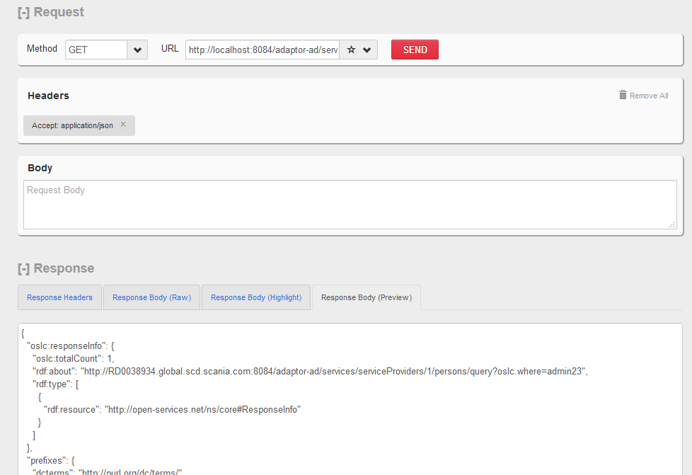
Test Query Capability
http://localhost:8082/adaptor-ad/services/serviceProviders/1/persons/query?oslc.where=admin
http://localhost:8082/adaptor-ad/services/serviceProviders/1/persons/query?oslc.where=admin23
Why is the person URI on port 8004??

Slide 74
Call Query Capability from JIRA Adaptor
Implement queryPersonURI() method in the JIRA adaptor
<services\JiraWebhooksService.java>
public URI queryPersonURI(String name) {
ServiceProviderCatalog spc = null;
try {
spc = ActiveDirectoryAdaptorClient.getServiceProviderCatalog();
} catch (Exception e) {
log.error("Failed to get the ServiceProviderCatalog", e);
return null;
}
ServiceProvider sp = spc.getServiceProviders()[0];
Service s = sp.getServices()[0];
QueryCapability qc = s.getQueryCapabilities()[0];
URI queryBase = qc.getQueryBase();
String where = name;
OslcClient client = new OslcClient();
OslcQueryParameters queryParameters = new OslcQueryParameters();
queryParameters.setWhere(where);
OslcQuery query = new OslcQuery(client, queryBase.toString(), queryParameters);
OslcQueryResult queryResults = query.submit();
String[] urls = queryResults.getMembersUrls();
if (urls.length == 0) {
log.error("No User instance identified with name:" + name);
return null;
}
if (urls.length > 1) {
log.error("More than one User instance identified with name:" + name);
return null;
}
try {
return new URI(urls[0]);
} catch (URISyntaxException e) {
log.error("URISyntaxException occured when querying for name:" + name);
return null;
}
}

Slide 75
Call Query Capability from JIRA Adaptor
Modify getChangeRequest() method to query for the Creator Person.
<services\JiraWebhooksService.java>
LinkedHashMap<String, Object> creatorData = (LinkedHashMap<String, Object>) issueFieldsData.get("creator");
URI personURI = queryPersonURI((String) creatorData.get("key"));
aChangeRequest.setCreator(new Link (personURI));
aChangeRequest.setAbout(ChangeRequest.constructURI("1", aChangeRequest.getIdentifier()));
Test!
You need to run both adaptors!

Slide 76
That’s It!
What did you find missing?
Ideas for a next Workshop?
Did the workshop meet your state expectations?

Slide 77
Tips & Helpful Info

Slide 78
About JAX-RS
Java API for RESTful Web Services
Support in creating web services according to the REST architectural pattern
Provides annotations to map a class/method to a service
@Path - specifies the relative path for a resource class or method.
@Path("serviceProviders/{spId}/ChangeRequests")
public class ChangeRequestService {
...
@POST
@Path("create")
@Consumes({OslcMediaType.APPLICATION_RDF_XML})
@Produces({OslcMediaType.APPLICATION_RDF_XML})
public Response createResource(@PathParam(“spId") final String id,
final ChangeRequest aResource) {
ChangeRequest newResource = ...;
return Response.created(...).entity(newResource).build();
...
@PathParam - binds the method parameter to a path segment.
@GET, @PUT, @POST, @DELETE - specify the HTTP request type of a resource.
@Consumes/Produces - specifies the accepted/response media types
Notes:
Example media types: "image/png“, “application/json” or “application/xml”, or "text/html"

Slide 79
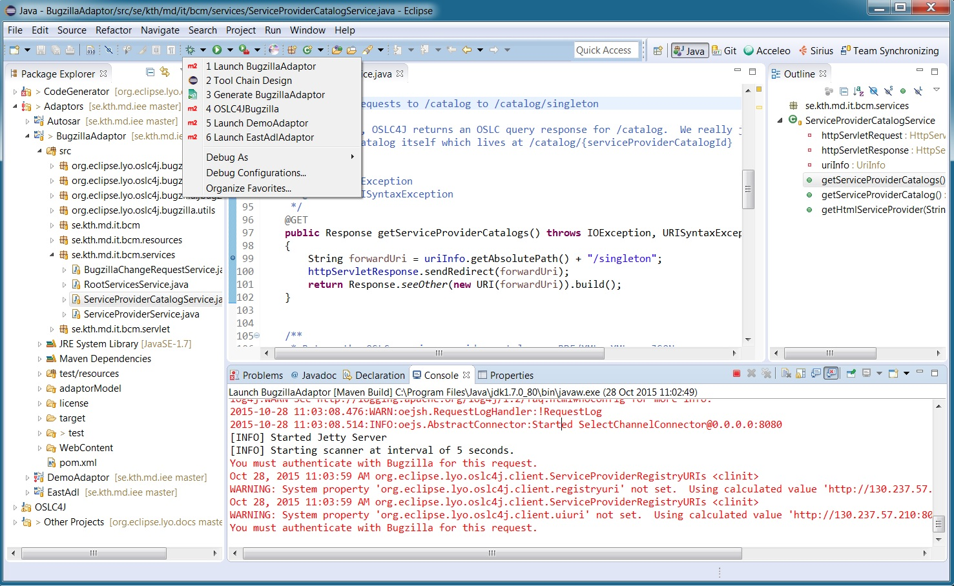
Debugging in Eclipse
Run
Debug
Select “Launch BugzillaAdaptor” to start webserver
Double-click on column to set a breakpoint
Press to stop the web server

Slide 80
Identify the Service Providers
Determine the organizational concept in Bugzilla that best maps to OSLC Service Providers
the central organizing concept that represents a “container” of resources.
→ In Bugzilla, bugs are organized by Product.
Architecture …
Define 1 Service Provider for each Product in Bugzilla
one Bugzilla instance can have multiple Products
Each Service Provider provides following services:
1 Delegated UI for bug selection
1 Delegated UI for bug creation
1 Query Capability so that bugs can be queried
1 Creation Factory so that new bugs can be created
Notes:
In Bugzilla, bugs are organized by Product.
Before you can use Bugzilla, you have to tell the system which Products exist in order to report bugs against them.

